Slide 1
Fitness Guru
Your Fitness Assistant
Vishnu Prabhakaran
215293431

Slide 2
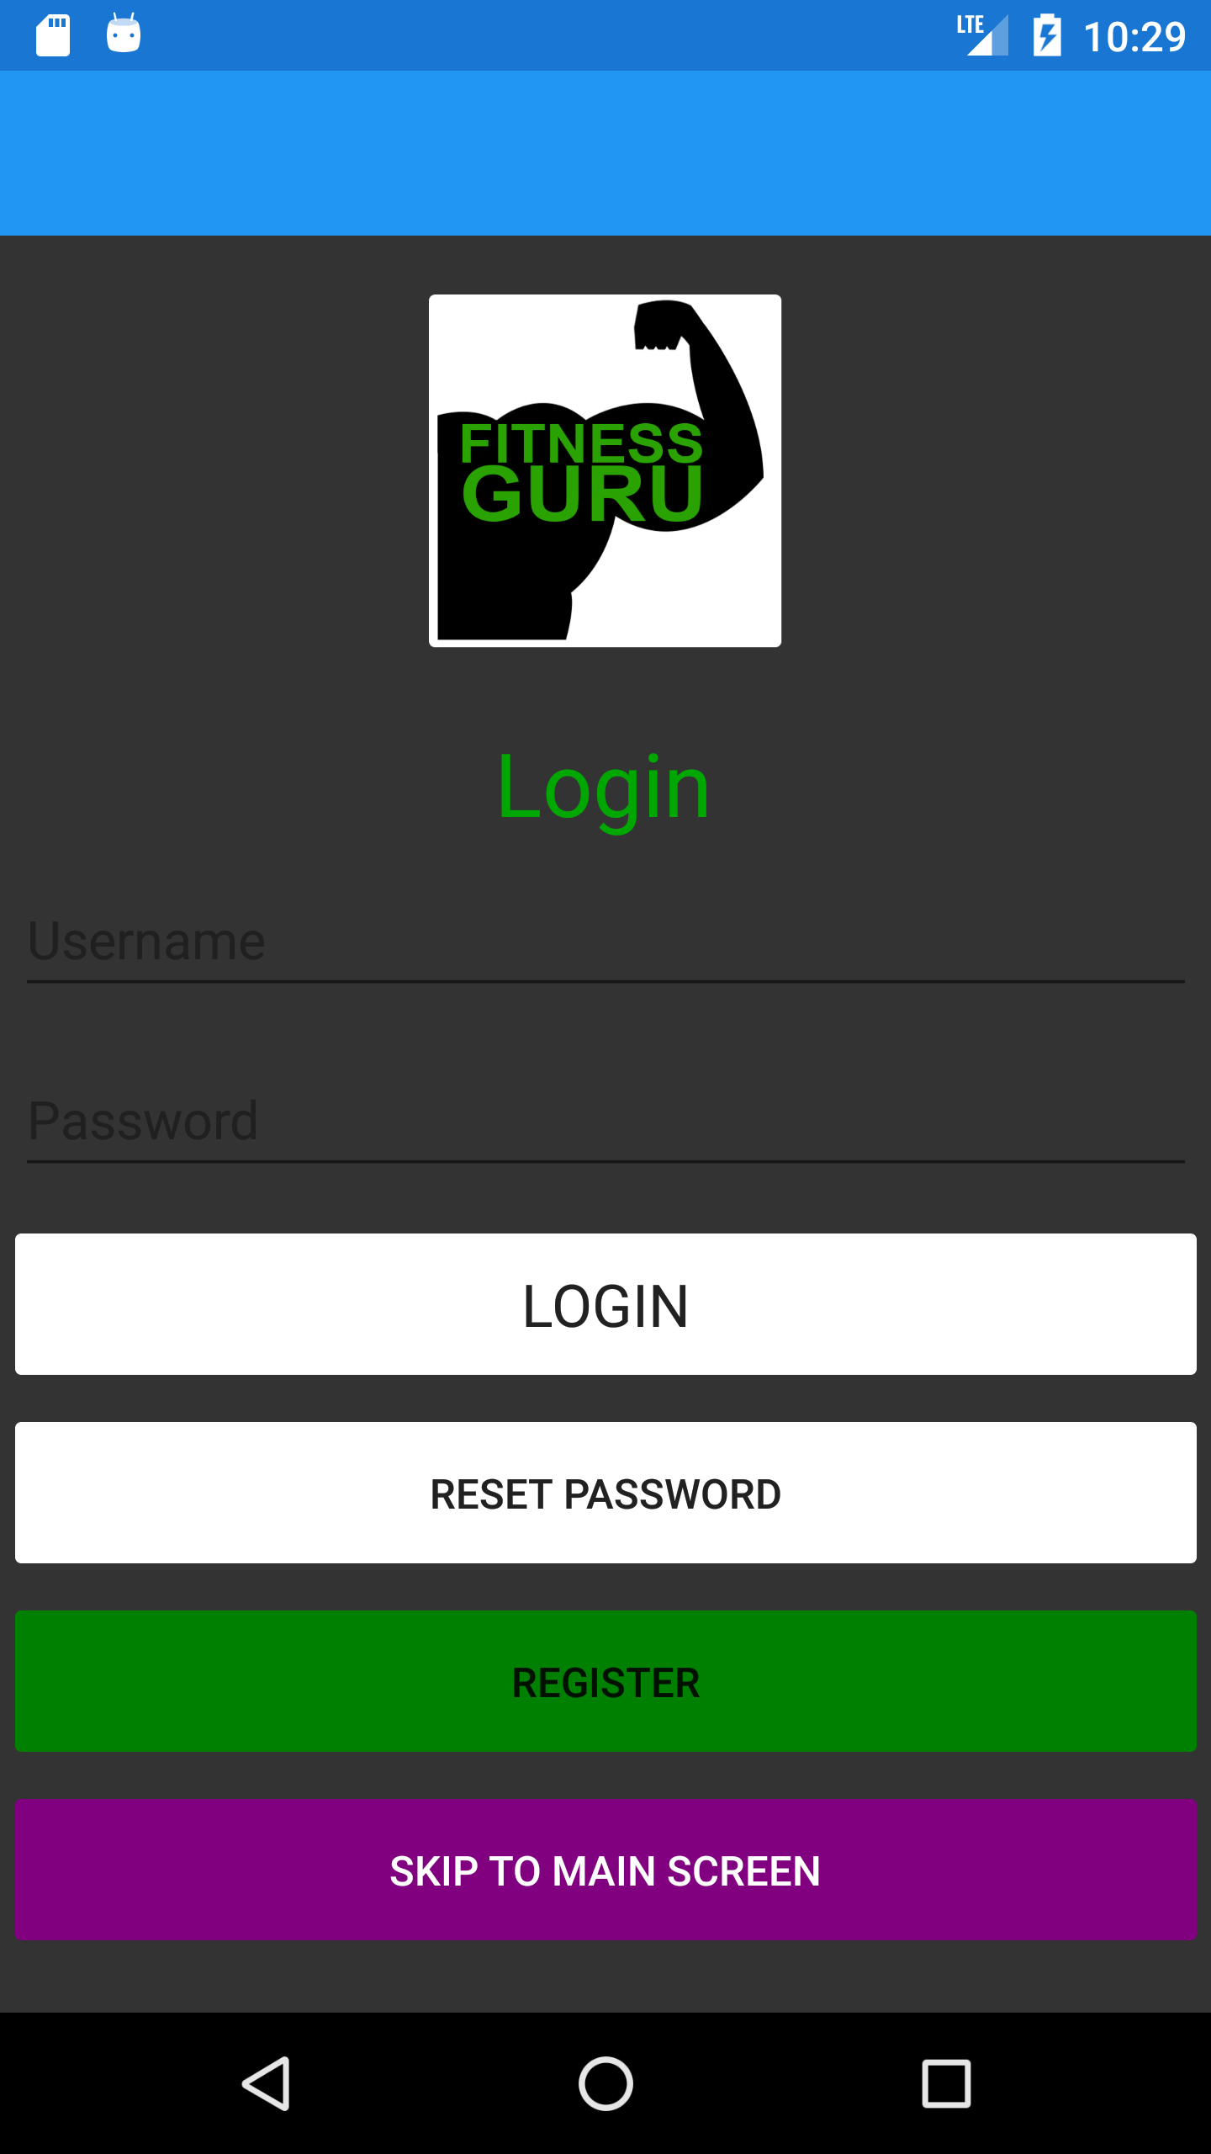
Login Screen
Login Screen with Login Details, Reset password, Register, and Skip to Main Screen

Slide 3
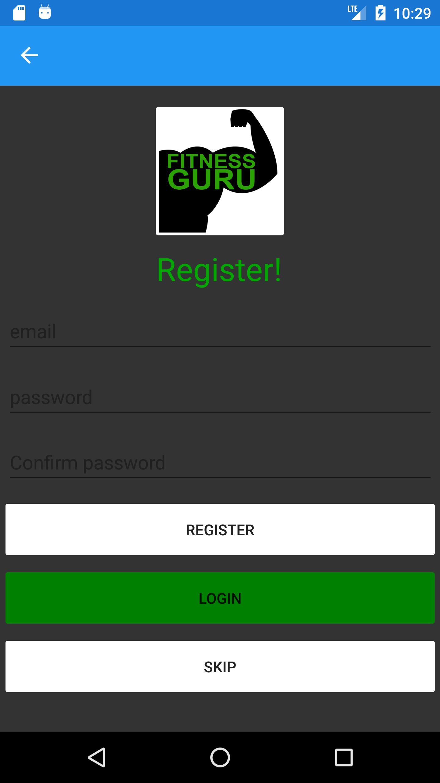
Register Screen
Register Screen with registration details and skip button

Slide 4
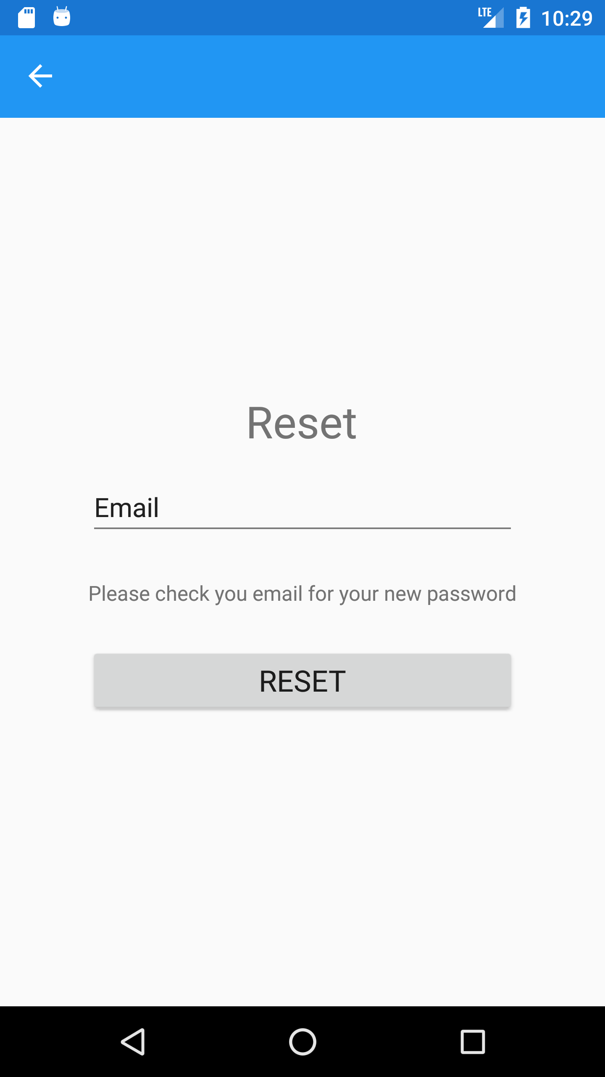
Reset password Screen
Reset password screen to retrieve the lost password.

Slide 5

Main Screen
Main landing Screen with tab bar containing Home page, Profile page, Workout page, Progress page, Menu page

Slide 6
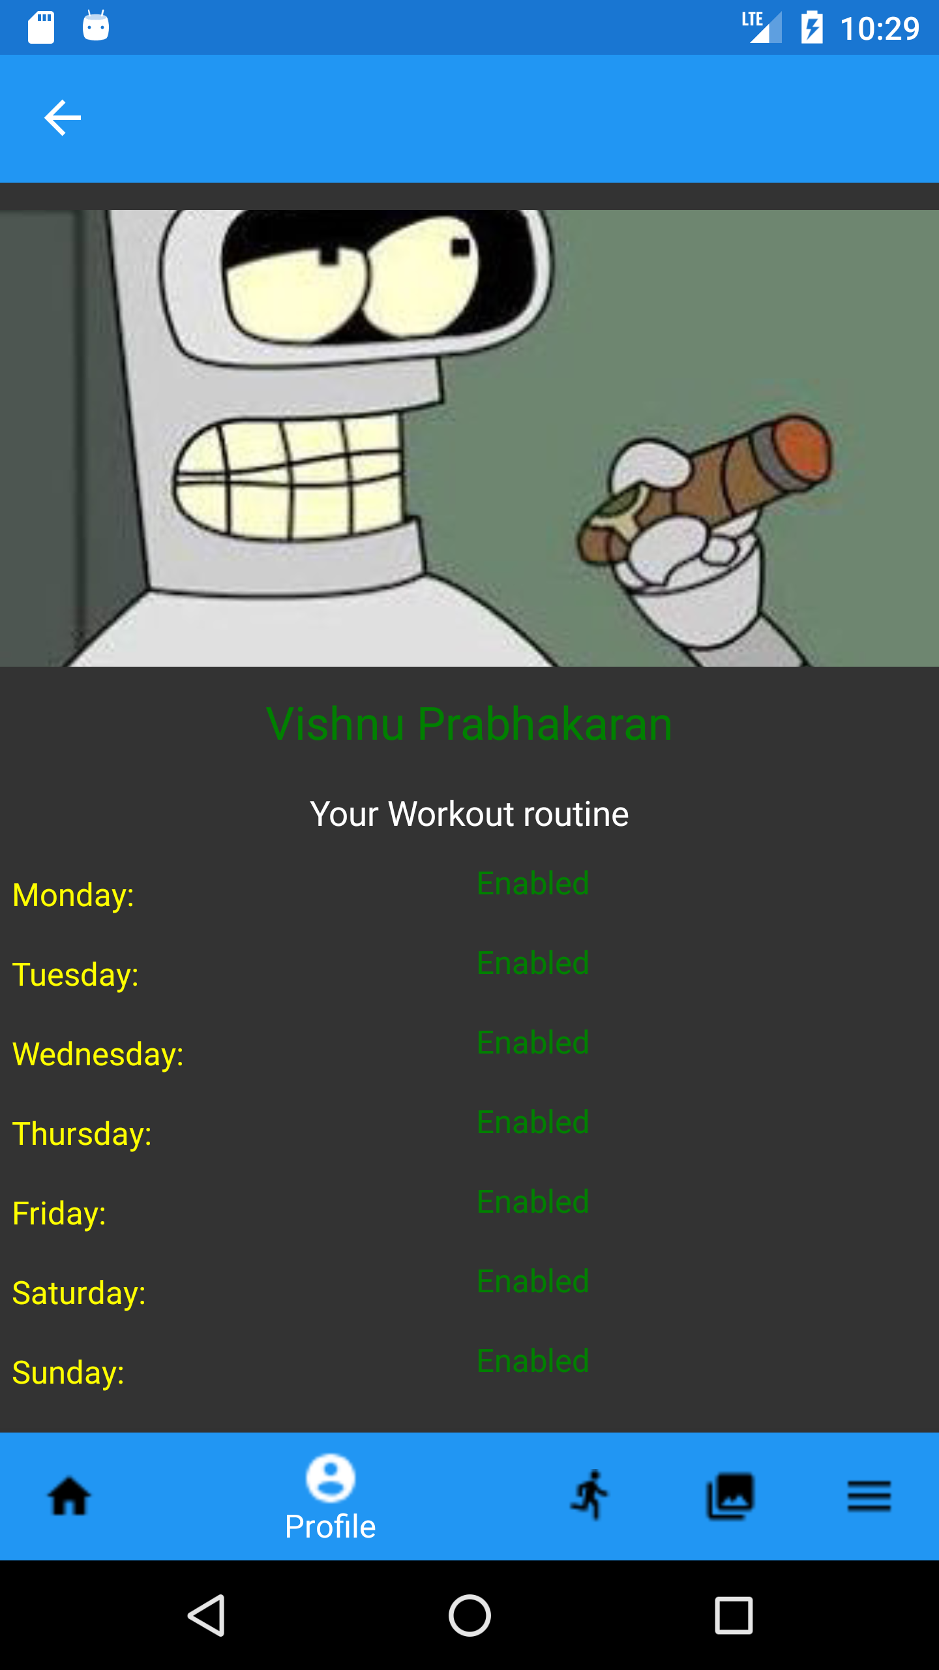
Profile Screen
Profile page containing your weekly workout routine.

Slide 7
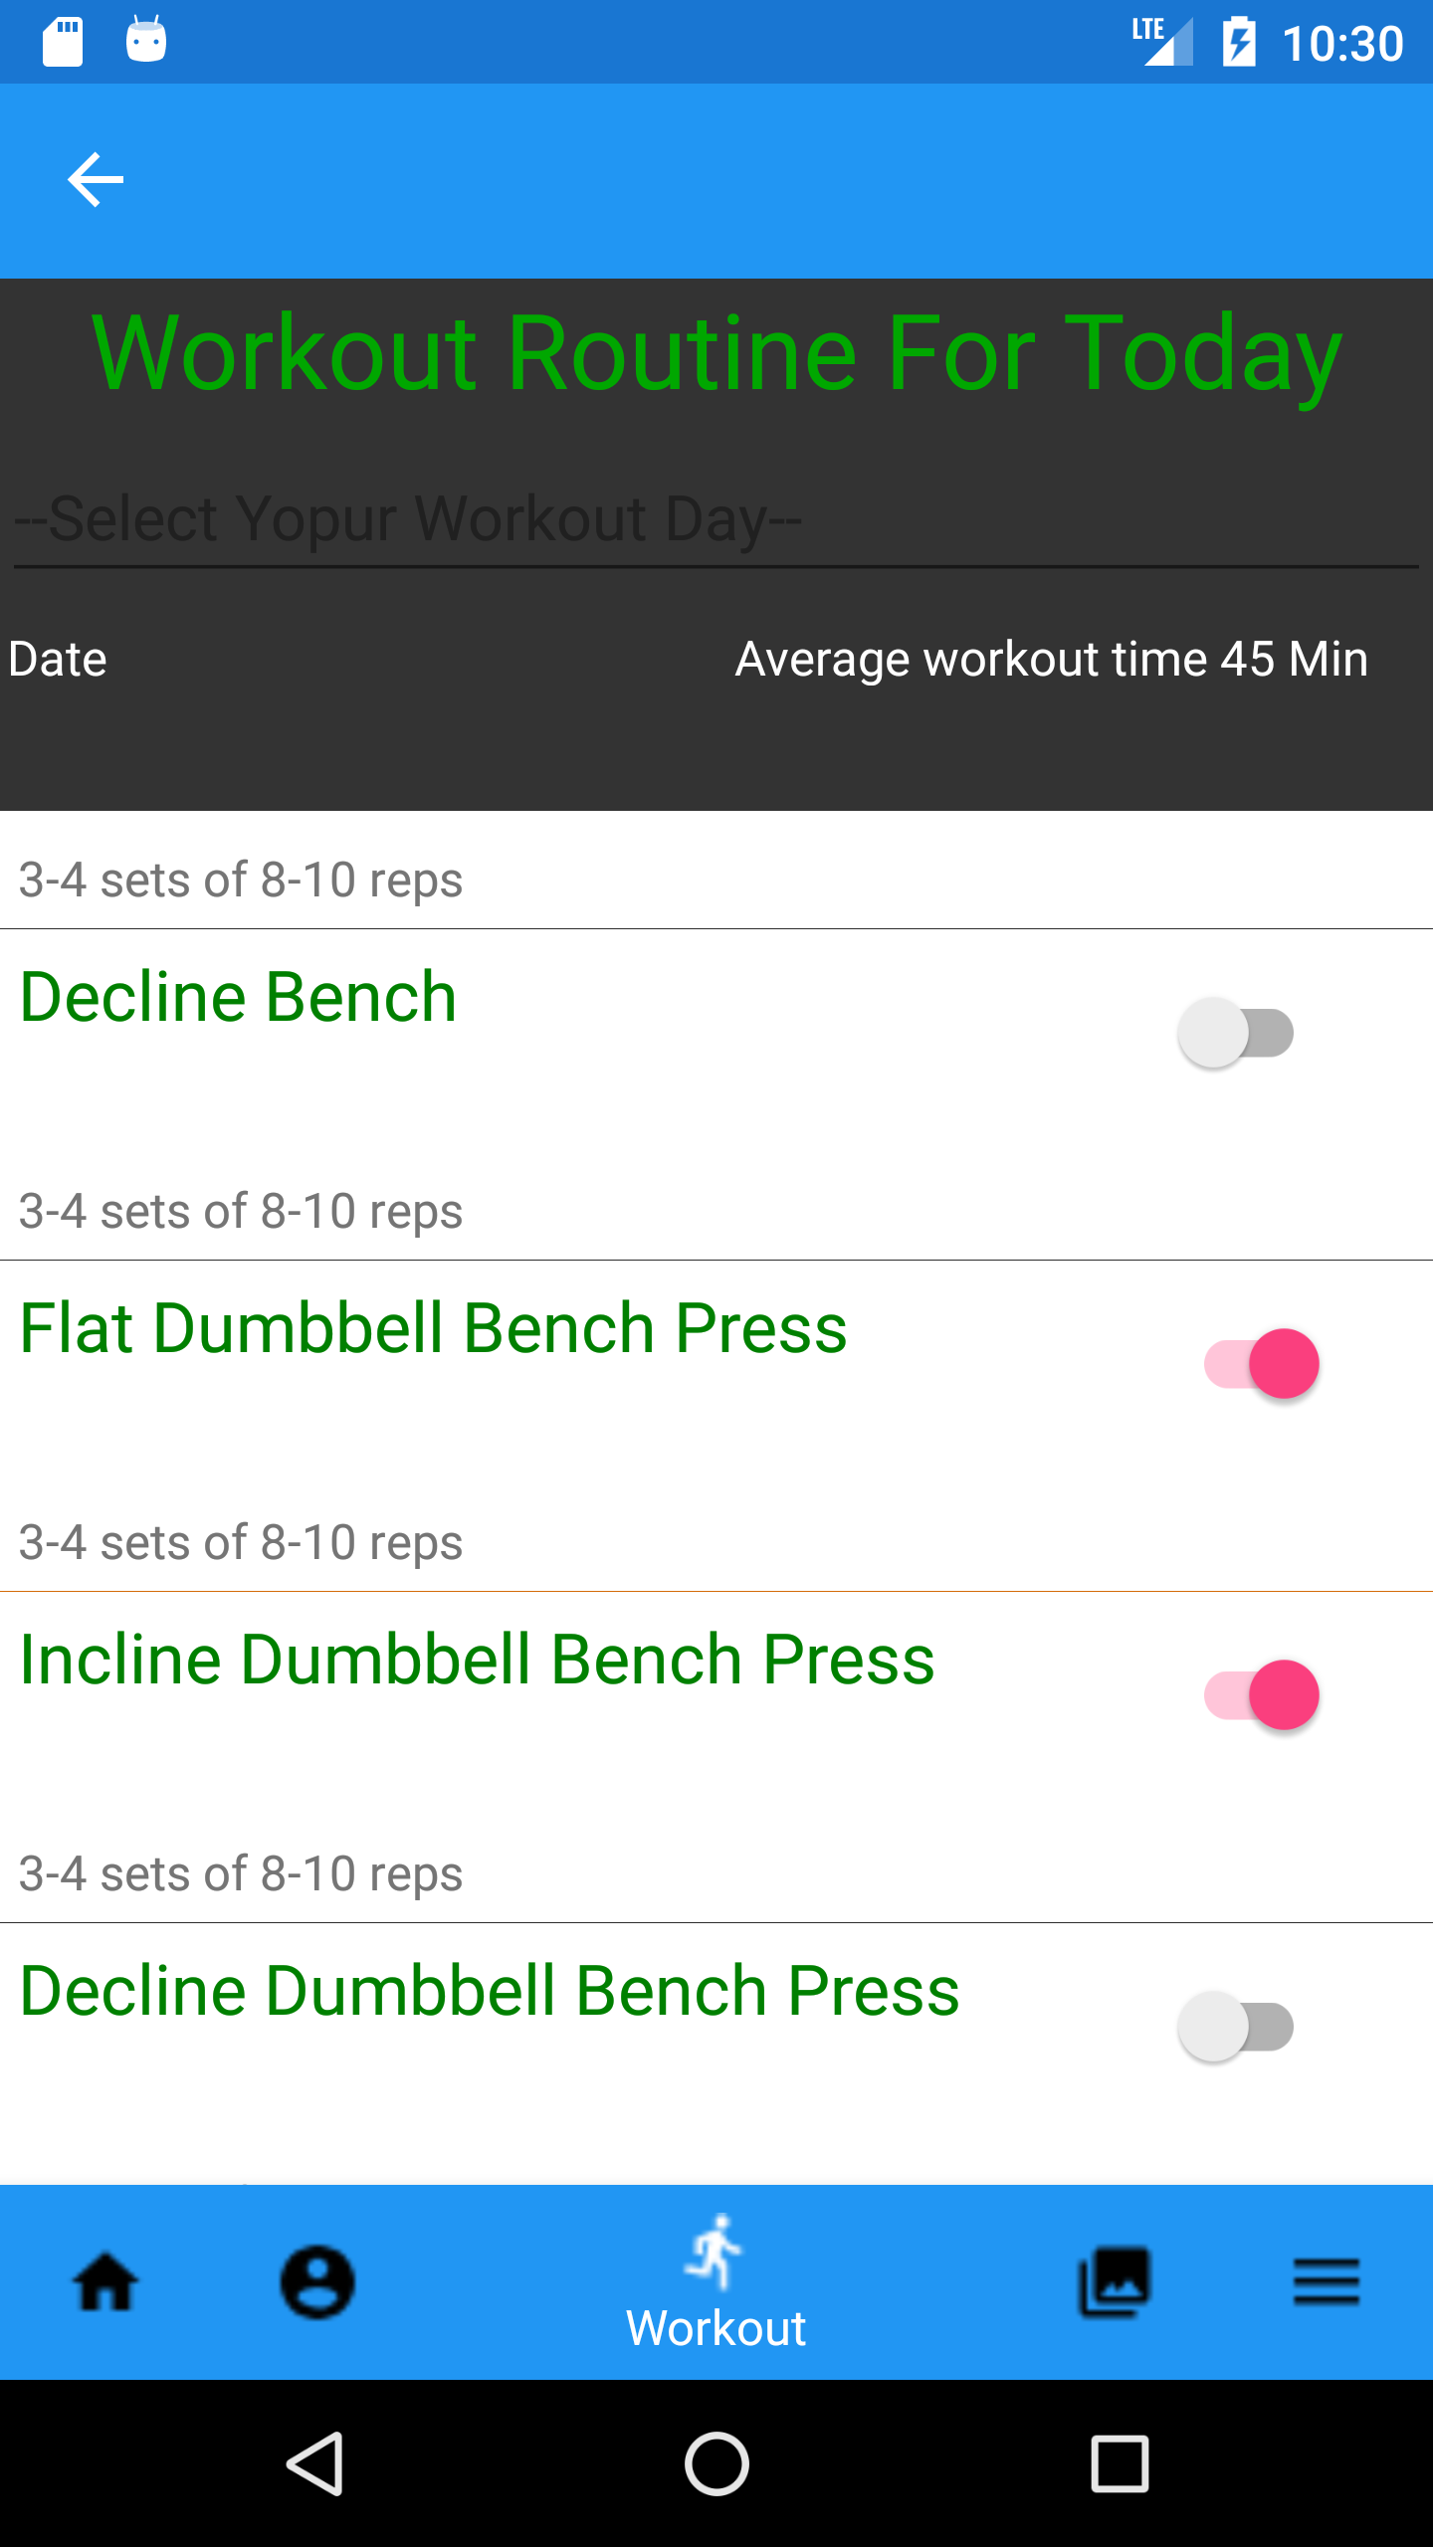
Workout Screen
Workout screen where the data is loaded from the external Api.
You can then mark it as completed as you workout.

Slide 8
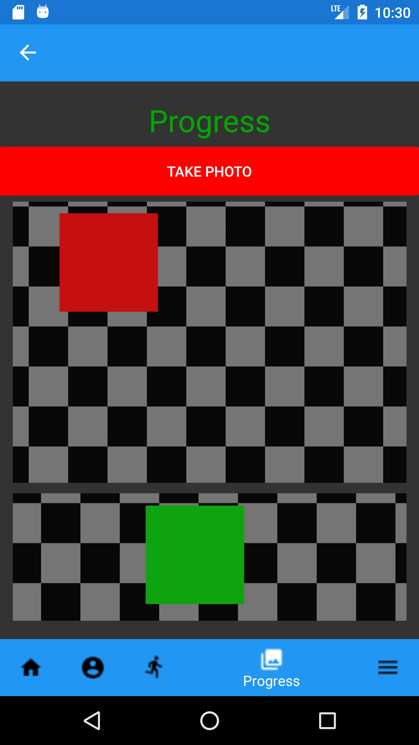
Progress Screen
Progress screen help you take your pictures from week1 when you start the workout
The Screen also lists the images that you took

Slide 9
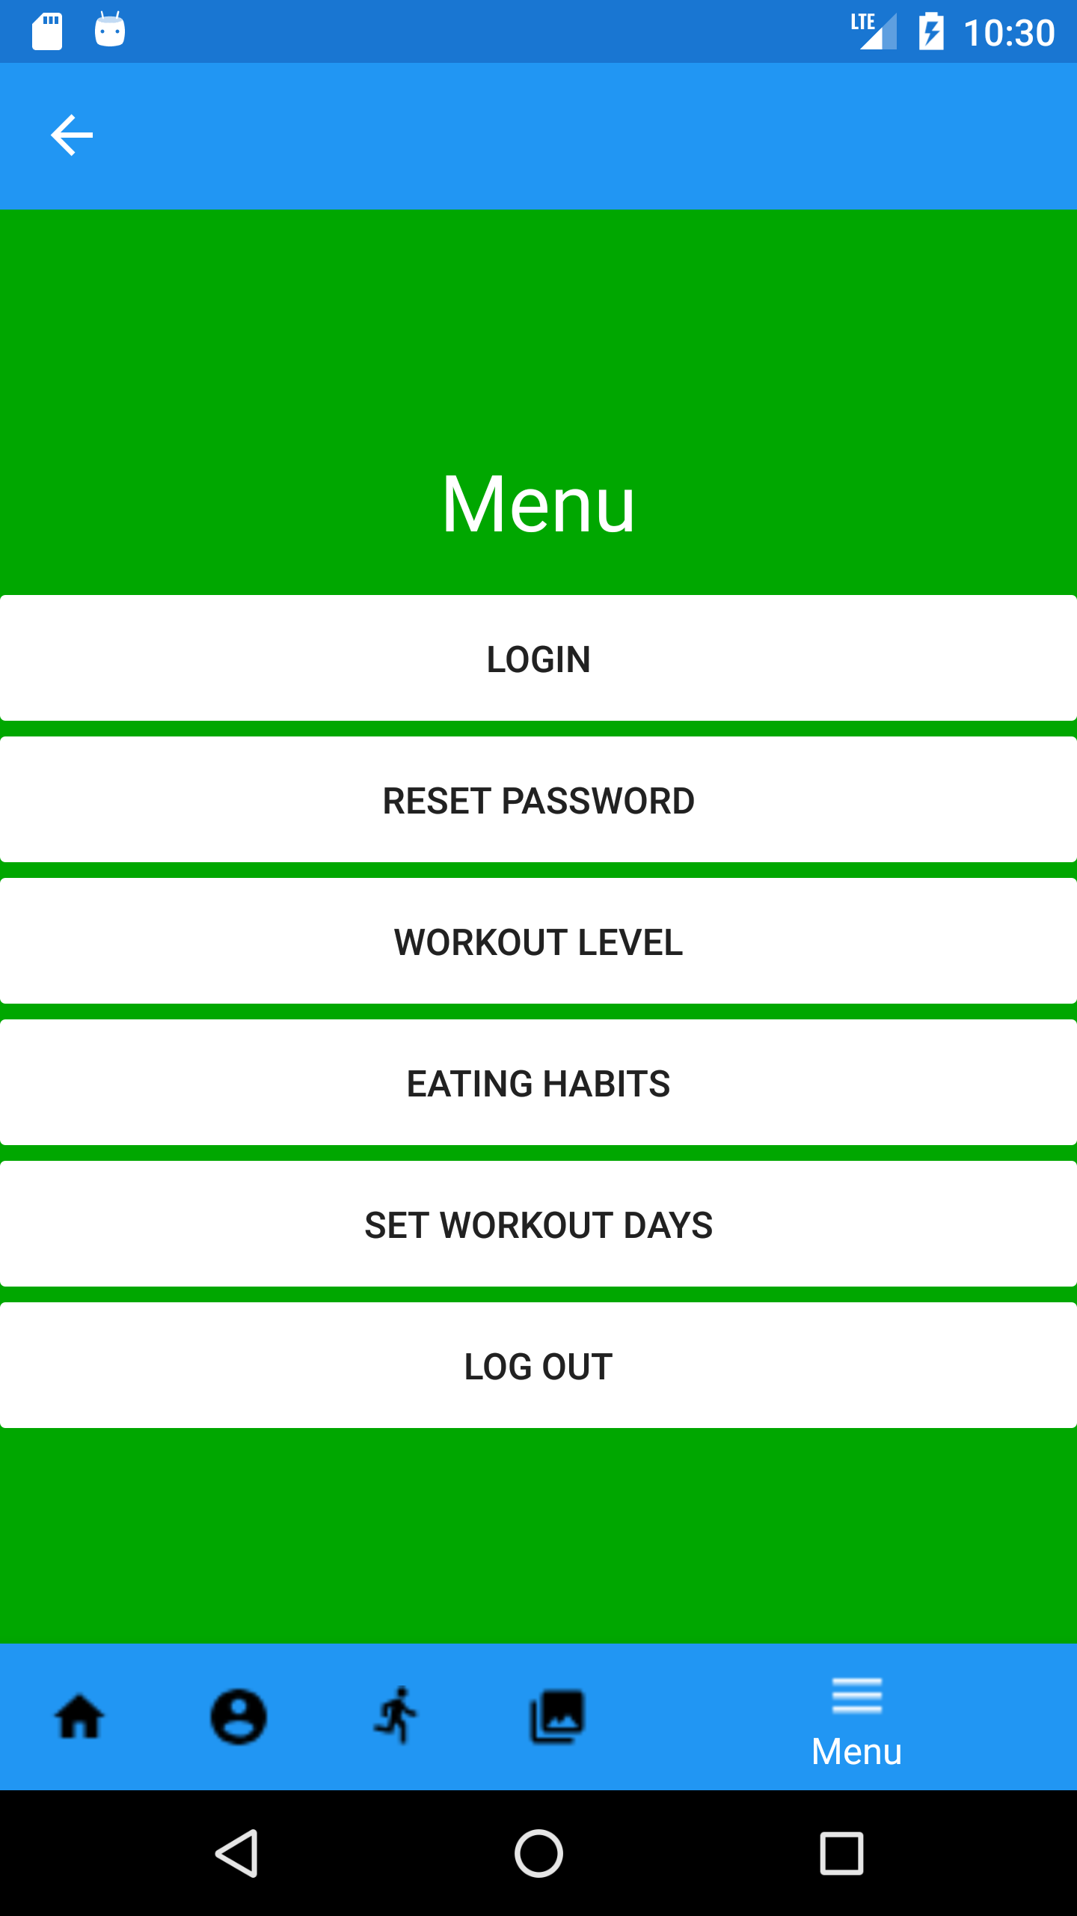
Menu Screen
Menu page contains extra additional menus
Other than the Login and reset it has
Workout level, Eating Habits, Set workout days and Logout

Slide 10
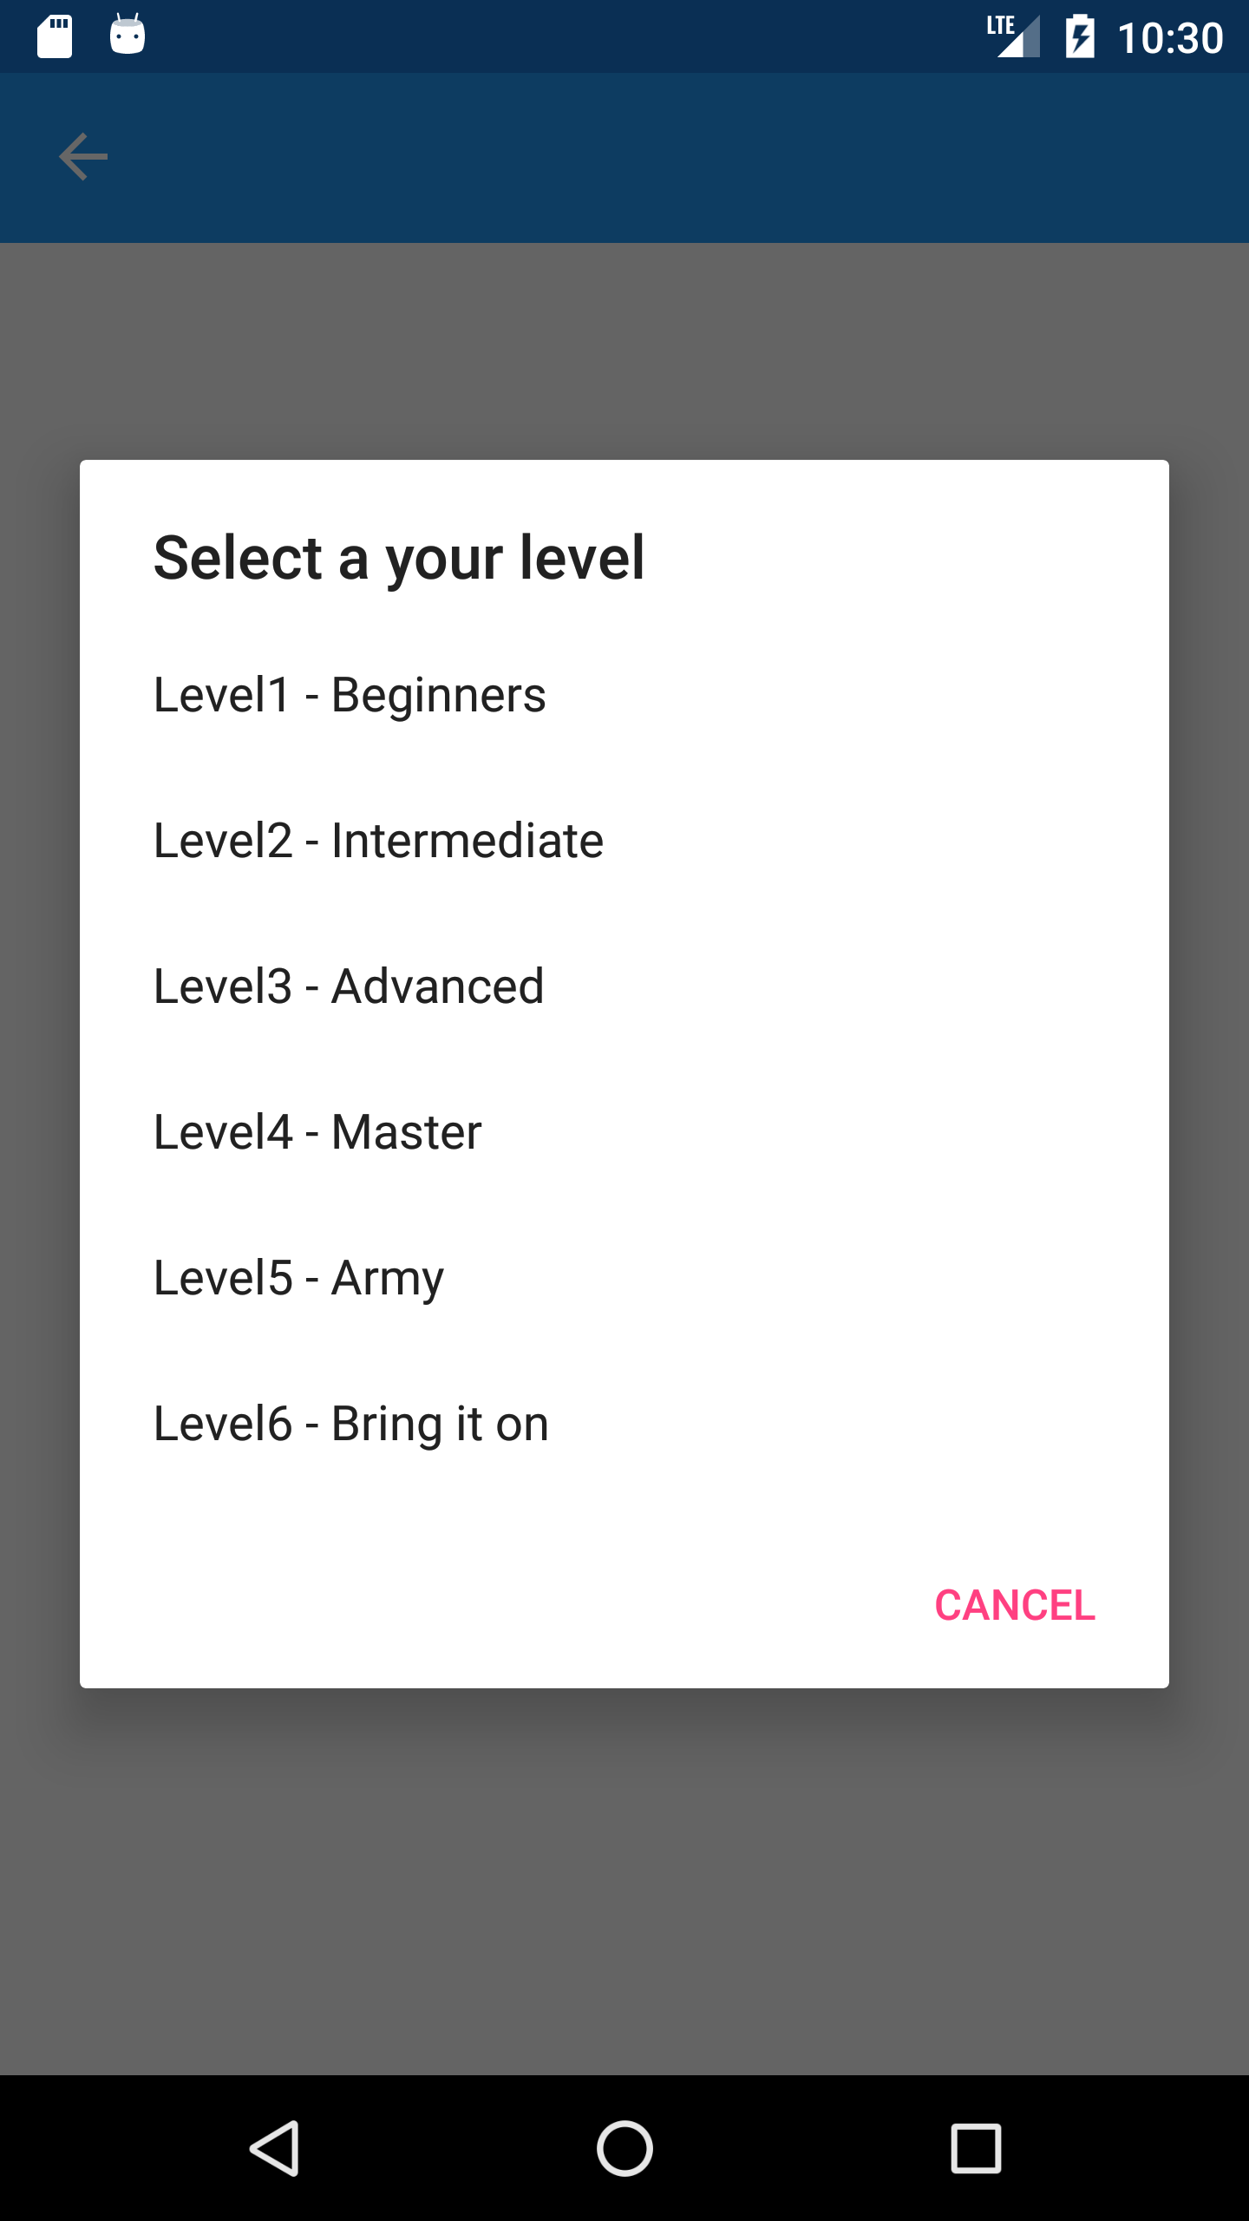
Workout Level Screen
Here is where you set out your work out level,
And your reps and counts change as you progress.

Slide 11
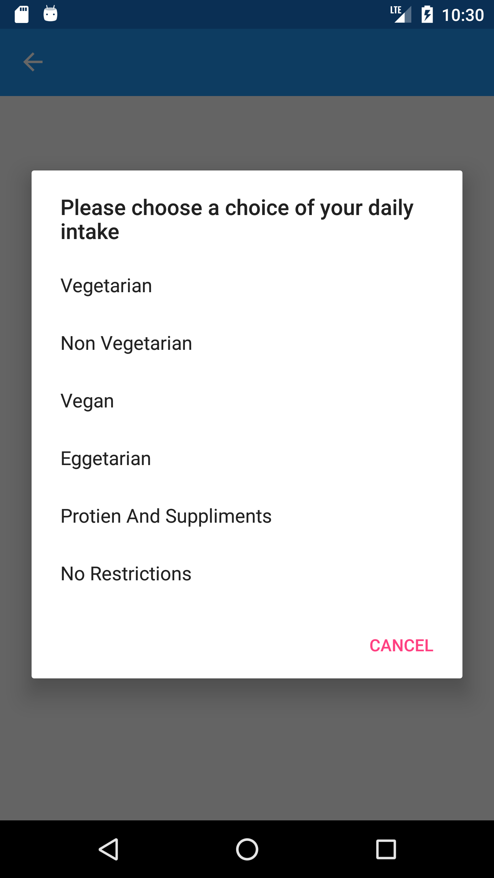
Eating Habits Screen
Here is where you set your eating habits
The home screen should show the images and tips based on your eating habits.

Slide 12
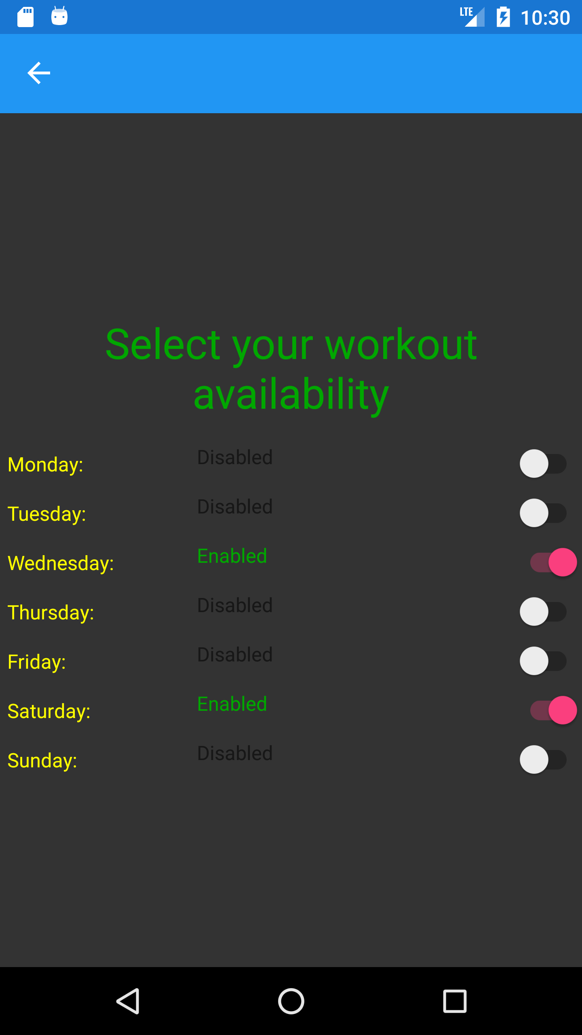
Workout Availabity Screen
Here is where you set your workout availability
And it should reflect the profile page

